Slide 1
Hugh Harford
Posco Consulting
Late 2017
An outline of the Condor GP Design
.
THE DESIGN

Slide 2
About this deck
This deck is in two parts
Firstly, diagrams and a little text to describe a little of the design core
Secondly, text to describe Epics and Stories – these are a good first draft to describe the functionality of the wider design
The immediate objective of this deck is to attempt a first view of the non-functional requirements
For the stories on these, skip to the penultimate slide

Slide 3
Part One – Design Outline

Slide 4

Design Outline: Core Element - Genetic Programming and Trading
Evolution
Fitness
Genetic Programming (GP)
Trading analysis
(will later provide market access)

Slide 5

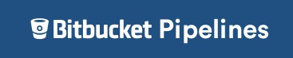
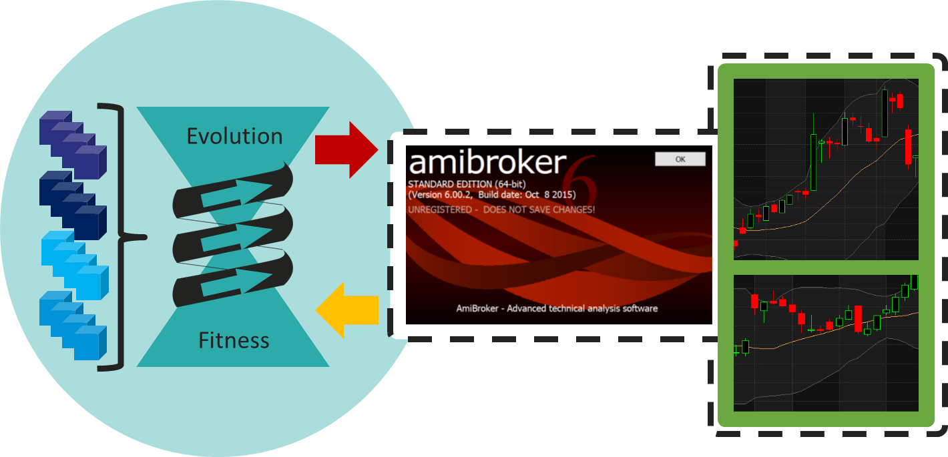
Production Environments
Eyrie Review
Analysis & Decision Making
Evolution Processing
Posco hardware
Input
data
Analysis
&
Decisions
Setup
data
Eyrie Progress
Posco hardware (master)
AWS or similar (slave)
Serialised

Slide 6
Design Block Diagram
Eyrie Progress
Building Blocks (Function and Terminal Sets)
This shows Phase 1, the MVP. Later Phases add functionality
Phase 1 MVP is evolution with data recording, excluding, for example, the Living Cells
Phase 1 shows viability in external processing, e.g. AWS, and therefore achieve builds and serialisation
CondorGP Setups
Syntax and Parameters
CondorGP
database
Parameters
ECJ
Checkpointed Population, Fitness and Resource data

Slide 7
Part Two – Design Epics

Slide 8
30/12/17: See Rows 10672 & ff
Functionality and Epics
Undertake and visualise Data Analyses
Perform the range of analyses of GP and Trading and provide graphic views thereof
Analyse and specify Setups
Specify Setups, by processing existing results and new and existing search space progress
Define GP Core input
Create full 'Setups' using Parameters controlling GP output syntax, Fitness Function, Building Blocks, and Prioritised Evolution
Run GP Core
Progress prioritised evolution of existing and new GP Populations (both simple and advanced)
Data Output
Capture and store the requisite data for future analyses
Run Living Cell (paper / £) process
Run LC process to trade, keep Cells updated based on trading results, sapping, growth, clone, death
Provide a scalable, linked process
Allow the many event steps and processing required to interlink and be undertaken to required timescales

Slide 9
Functionality and first pass Epics
A - Undertake and visualise Data Analyses
Perform the range of analyses of GP and Trading and provide graphic views thereof
Stories
Undertake the required analyses
Update the visualisations with the latest analysis data
Notes
Analysis required not listed in full at this point
Analysis will likely cover the following areas / questions:
Simple results from Evolving Populations (Fitness improvement, consistency of improvement)
More advanced results from Evolving Populations (Genetic diversity, local minima identification)
Wider evolutionary results: e.g. Which Building Blocks (FnT) are most influential (single and groups of Building Blocks)
Results from Living Cells (Trading performance, Cell population stats, income stability and longevity)

Slide 10
Stories for each Epic
B - Analyse and specify Setups
Specify Setups, by processing existing results and new and existing search space progress
Stories
Make ready a list of defined and prioritised Setups to be selected from and created when new input is needed to process the GP Core
Identify from Data Analysis results which Evolving Populations are worth progressing
Identify from Data Analysis results areas of the search space worth opening up or closing down

Slide 11
Stories for each Epic
C - Define GP Core input
Create full 'Setups' using Parameters controlling GP output syntax, Fitness Function, Building Blocks, and Prioritised Evolution
Stories
Create the Setup, specifying fitness function
Create the Building Blocks (Functions and Terminals set)
Confirm all possible syntax combinations are legal in output language
Place latest Setup in list of prioritised Setups for evolutionary progress by GP Core

Slide 12
Stories for each Epic
D - Run GP Core
Progress prioritised evolution of existing and new GP Populations (both simple and advanced)
Stories
Progress new Setups as created Evolving GP Populations, with 50 individuals and 100 generations
Progress all prioritised existing Evolving GP Populations, by 100 generations
Continue progressing Evolving GP Populations to make best use of alloted evolution resources
Establish new external (slave) populations
Progress existing checkpointed population externally as slave

Slide 13
Stories for each Epic
E - Data Output
Capture and store the requisite data for future analyses
Stories
Grab data at all the requisite timings across the process to enable later analysis
Store all data in a safe, ordered and accessible format for later analysis
Notes
Data output required not listed at this point
Data output will be required pre, post and during GP Core and Living Cell processing

Slide 14
Stories for each Epic
F - Run Living Cell (paper / £) process
Run LC process to trade, keep Cells updated based on trading results, sapping, growth, clone, death
Stories
Note: All Living Cells will be paper (i.e. not trading live) for the foreseeable future
Prioritise birth of new Living Cells with the each of the latest best new individuals from the GP Core Outputs
Birth new Living Cells
Clone Living Cells that are performing well
Kill off Living Cells that are not performing well
Sap Living Cells to provide reliable income from trading activity
Run Living Cells with latest data to establish trades and execute trade orders

Slide 15
Stories for each Epic
G - Provide a scalable, linked process
Allow the many event steps and processing required to interlink and be undertaken to required timescales
Stories
Updated market data is available for use, e.g. after market close trading
Living Cell processes run efficiently and within specified time allotted
GP Core progress according to the prioritised lists of 'Setups' and Evolving Populations
Data Analyses are undertaken when GP Core or Living Cell activities have completed
Data Output during or immediately after Living Cell, GP Core or Data Analysis processes
The activity cycle is repeatable at the specified frequency (currently set as weekly, could be daily)
Run GP Core according to latest priorities
Run Living Cells, trade as required
Analyse data and set ongoing priorities
When the activity cycle is adjusted, the processing is scaled and the cycle is thus achieved in the specified time
The cost and resource requirement for an activity cycle frequency and scale can be forecast

Slide 16
Events, min and max est. frequencies & est. timing

Slide 17
Thank you
Email address and website below
PLEASE ASK questions

